Slide 1
Image-Based BRDF Measurement
Liang Chen, He Qingyi, Xu Zhenghao

Slide 2
Content
Background
Framework
Result
Discussion

Slide 3
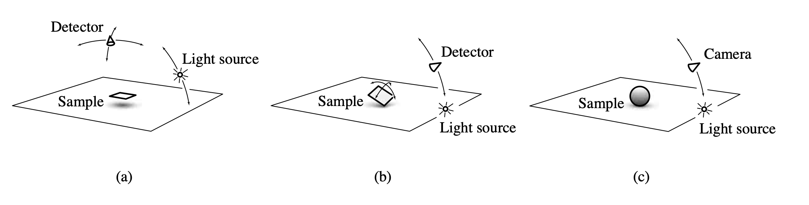
Background
Image-Based BRDF Measurement(Cornell University, January, 1999)

Slide 4
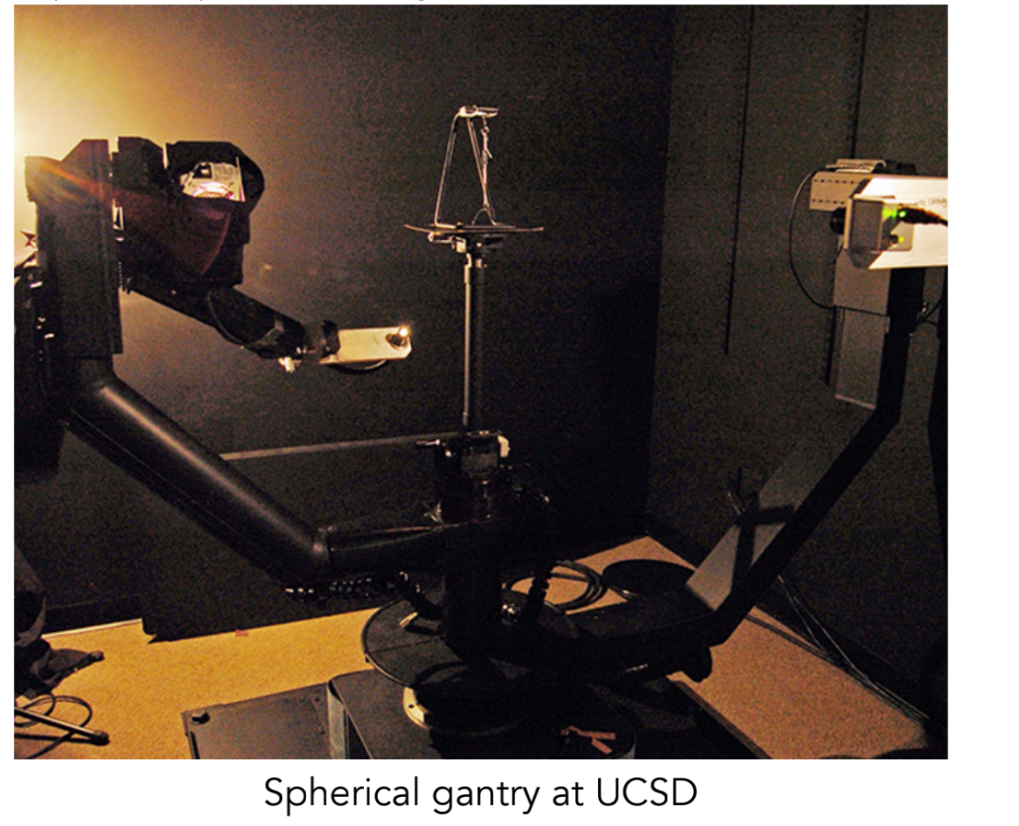
Background
Gonioreflectometer

Slide 5
Framework
Step 1. physical environment setup
Step 2. obtain positions
Step 3. BRDF Measurement
Step 4. reconstruction with measured BRDF

Slide 6
Physical Environment - Surrounding
A Box
Dark Enough -> Ripe out the influence of ambient light
Big Enough -> Provide enough space for measuring
What Else? -> Absorb light? With scale? Stability? …
Provide platform to place lighting source?（🍑）

Slide 7
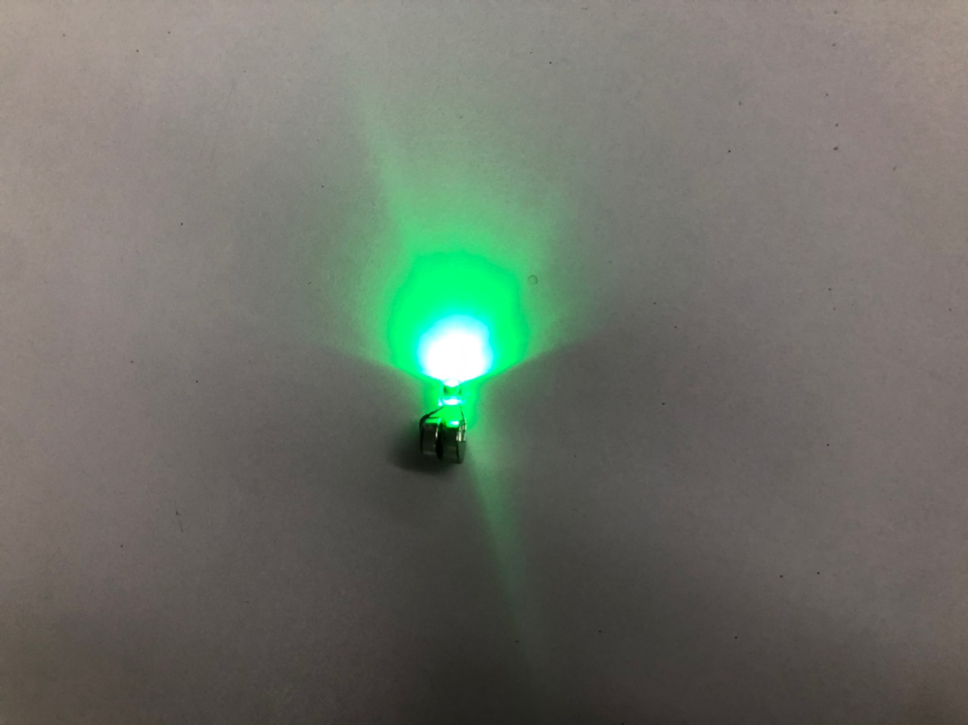
Physical Environment - Lighting
Point Light Source
LED Light Bulb?
Different Color
Perfect Point Shape

Slide 8
Physical Environment - Lighting
Point Light Source
LED Light Bulb?
Different Color
Perfect Point Shape
Poor Brightness
Poor Battery Capacity
Outer shell will distort the light
-> directly attach the light bulb to the battery
-> VERY DIFFICULT TO CONTROL

Slide 9
Physical Environment - Lighting
Point Light Source
Flash Light(Bicycle Front Light)?
Enough lighting

Slide 10
Physical Environment - Lighting
Point Light Source
Flash Light(Bicycle Front Light)?
Enough lighting
TOOOOOO Bright (Feature Lost)
TOOOOOO Big (Cannot Locate the Center)

Slide 11
Physical Environment - Lighting
Point Light Source
Mobile Phone’s Flashlight
Smaller, Easier to control
Modest Luminance
Nothing Special but really meet the requirements

Slide 12
Physical Environment - Camera
SLR with shutter line
Everything seems perfect until..

Slide 13
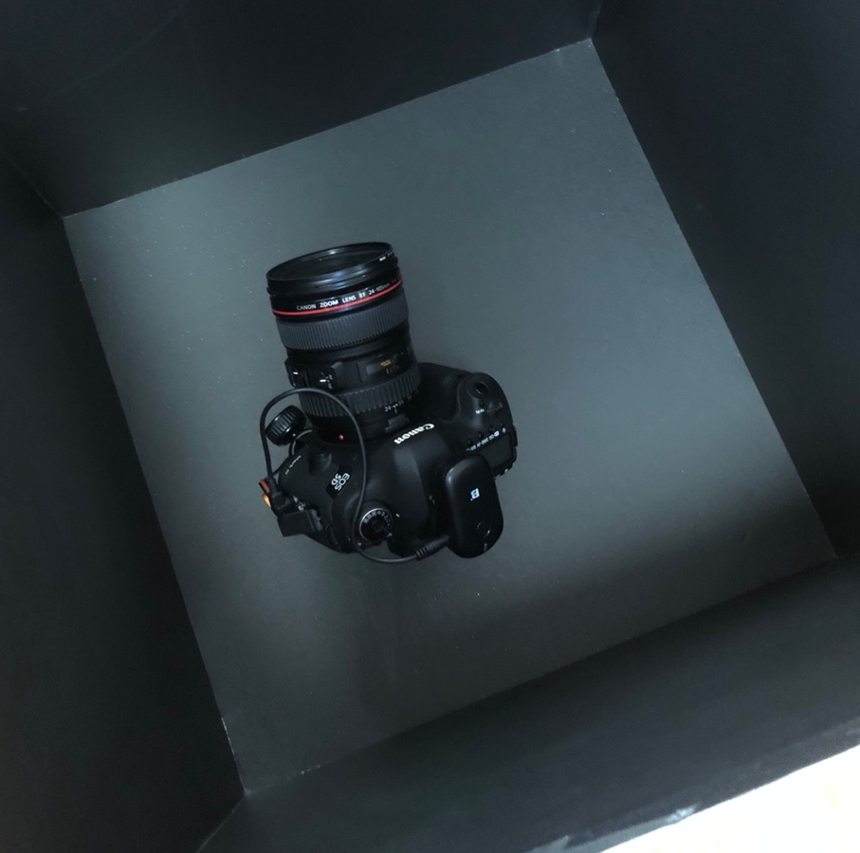
Physical Environment - Camera
SLR with shutter line
Everything seems perfect until..

Slide 14
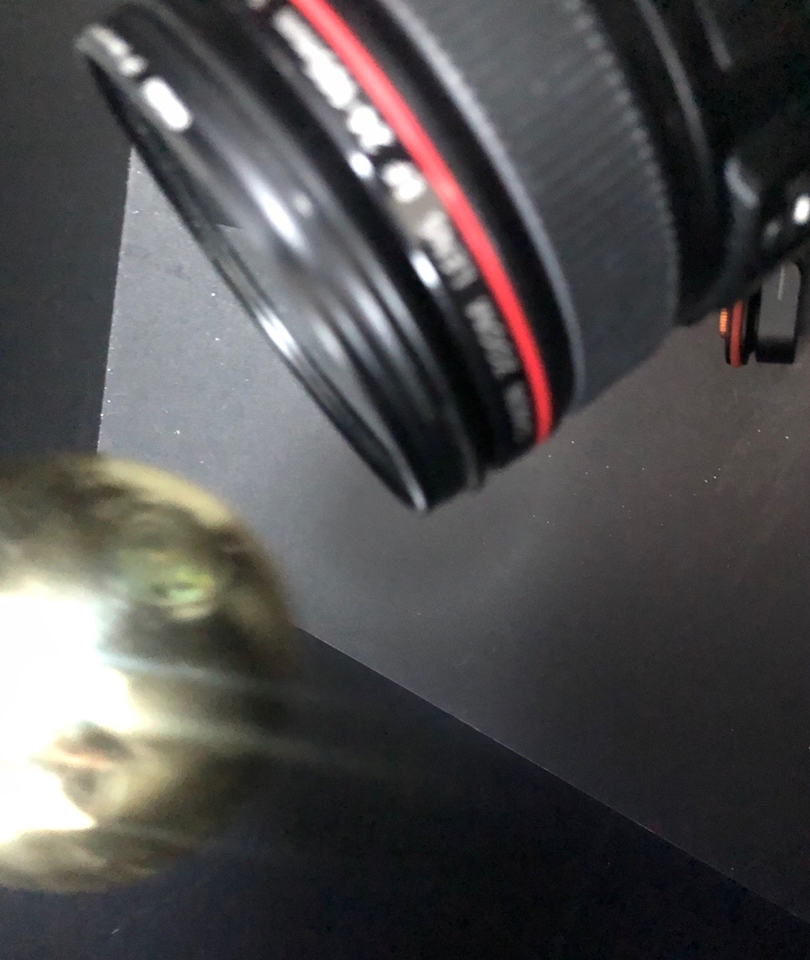
Physical Environment - Camera
SLR with shutter line
Everything seems perfect until..
They collided
iPhone with RCam/Manual Cam
It fixes the exposure and focus
It Provide

Slide 15
Physical Environment - Camera
SLR with shutter line
Everything seems perfect until..
They collided
iPhone with RCam/Manual Cam
It fixes the exposure and focus
It Provides every parameters

Slide 16
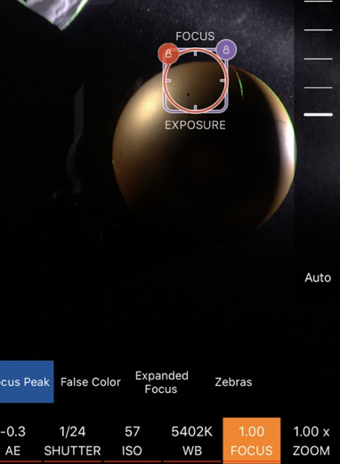
Physical Environment - Camera
SLR with shutter line
Everything seems perfect until..
They collided
iPhone with RCam/Manual Cam
It fixes the exposure and focus
It Provides every parameters

Slide 17
Physical Environment – Camera Carrier
Circular Slider? - 🍑
Use fixed-length rope?
Poor accuracy, hard to fix the length

Slide 18
Physical Environment – Camera Carrier
Circular Slider? - 🍑
Use fixed-length rope?
Poor accuracy, hard to fix the length
Little car

Slide 19
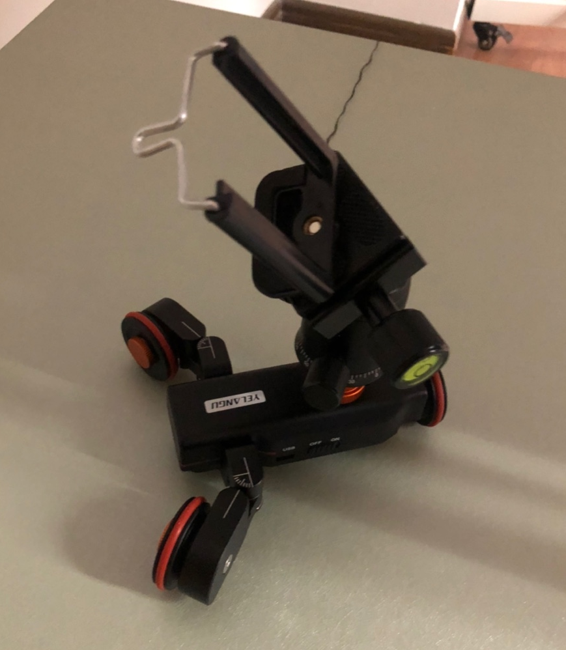
Physical Environment – Camera Carrier
Circular Slider? - 🍑
Use fixed-length rope?
Poor accuracy, hard to fix the length
Little car

Slide 20
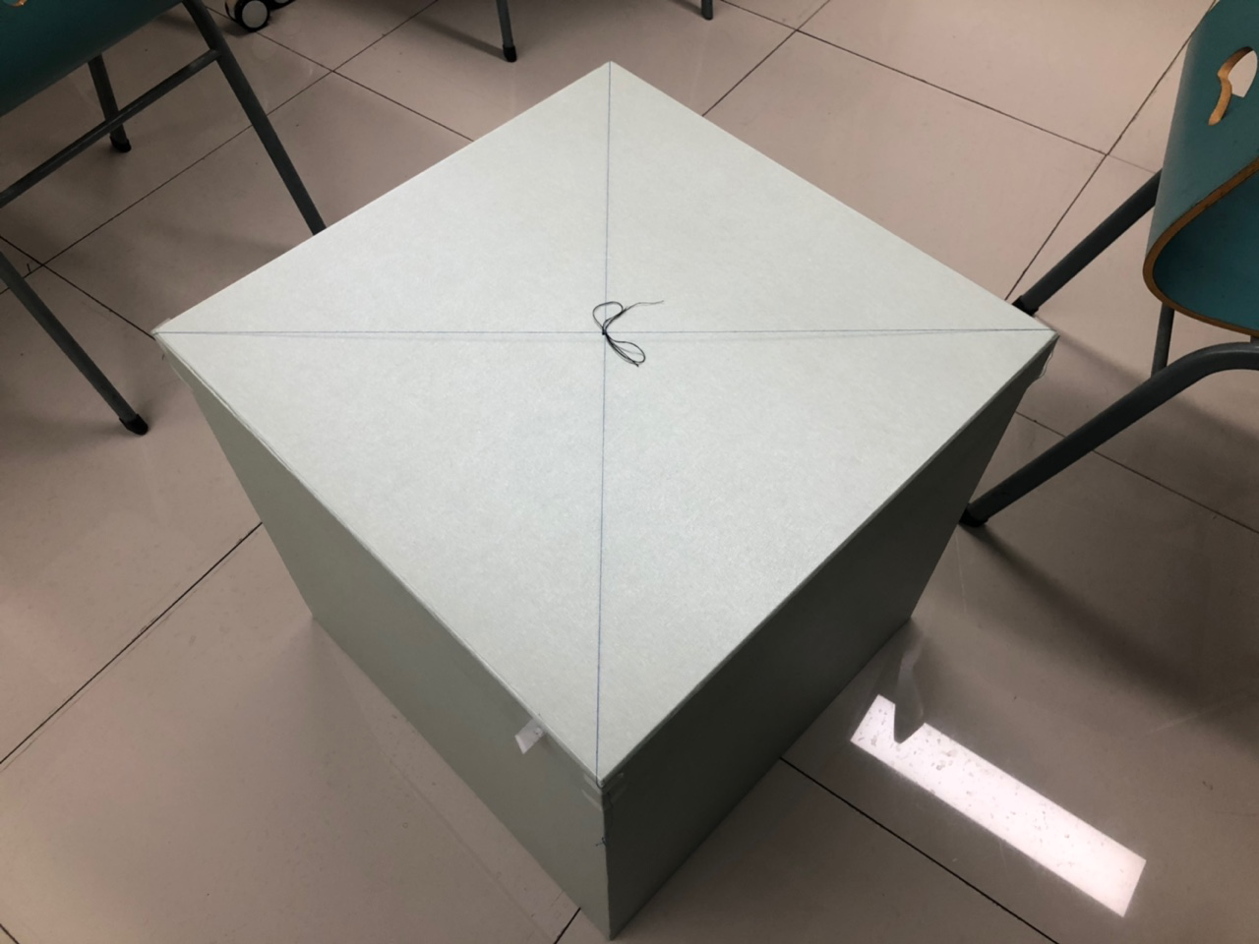
Physical Environment – What to measure?
Position
Easy but useful method to obtain the center of box

Slide 21
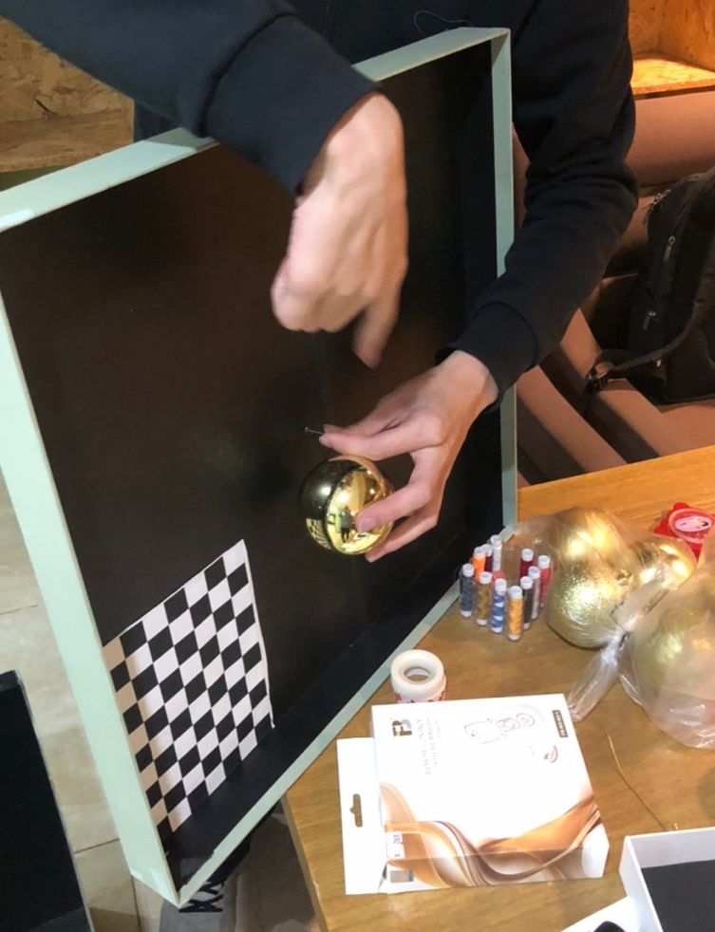
Physical Environment – What to measure?
Position
Easy but useful method to obtain the center of box

Slide 22
Physical Environment – What to measure?
Position
Easy but useful method to obtain the center of box
What Ball?
Ping-pong?
Wax Pill?
Christmas Ball!

Slide 23
Physical Environment – What to measure?
Position
Easy but useful method to obtain the center of box
What Ball?
Ping-pong?
Wax Pill?
Christmas Ball!
How to make it stable? - The ball swings all the time

Slide 24
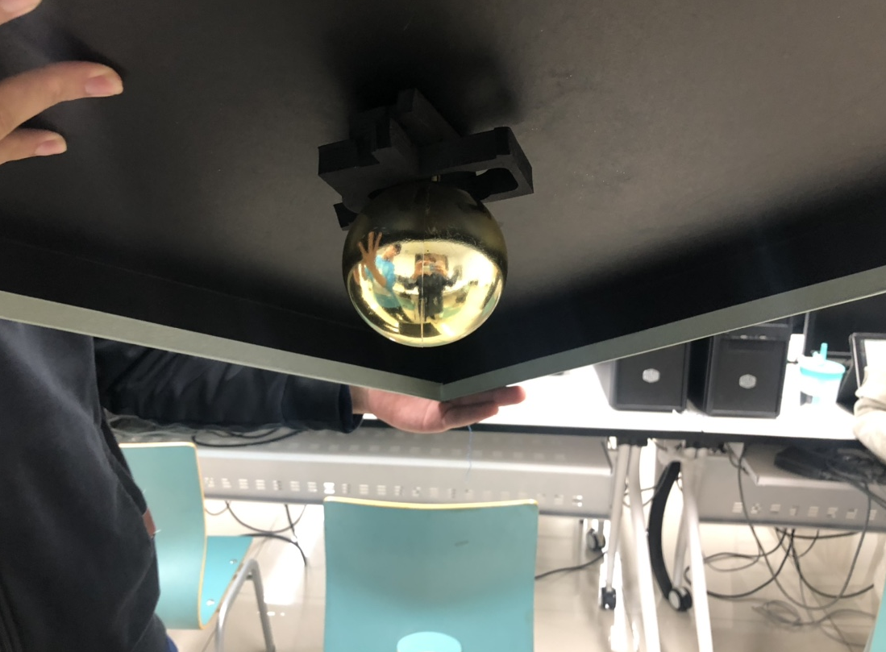
Physical Environment – What to measure?
Position
Easy but useful method to obtain the center of box
What Ball?
Ping-pong?
Wax Pill?
Christmas Ball!
How to make it stable? - The ball swings all the time

Slide 25
Calibration – Naïve Version
Soft ruler for balls’ radius
Steel tape for Box Size/Obj Position/Light Position

Slide 26
Calibration – Naïve Version
Soft ruler for balls’ radius
Steel tape for Box Size/Obj Position/Light Position
(Too young, too simple, sometimes naïve)

Slide 27
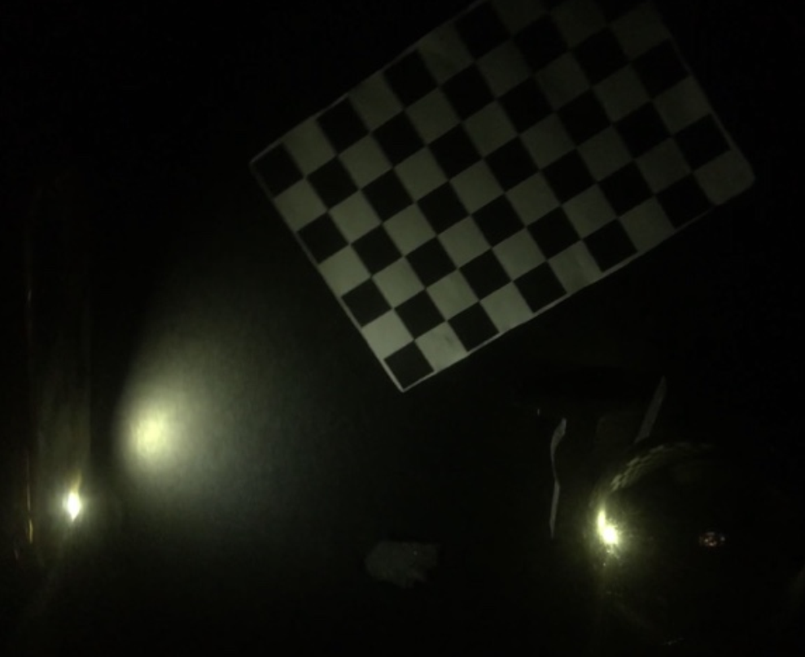
Camera Location
Camera calibration & pose estimation
Use a photos of multiple cycles to synchronize angles
Get position and direction for each angle

Slide 28
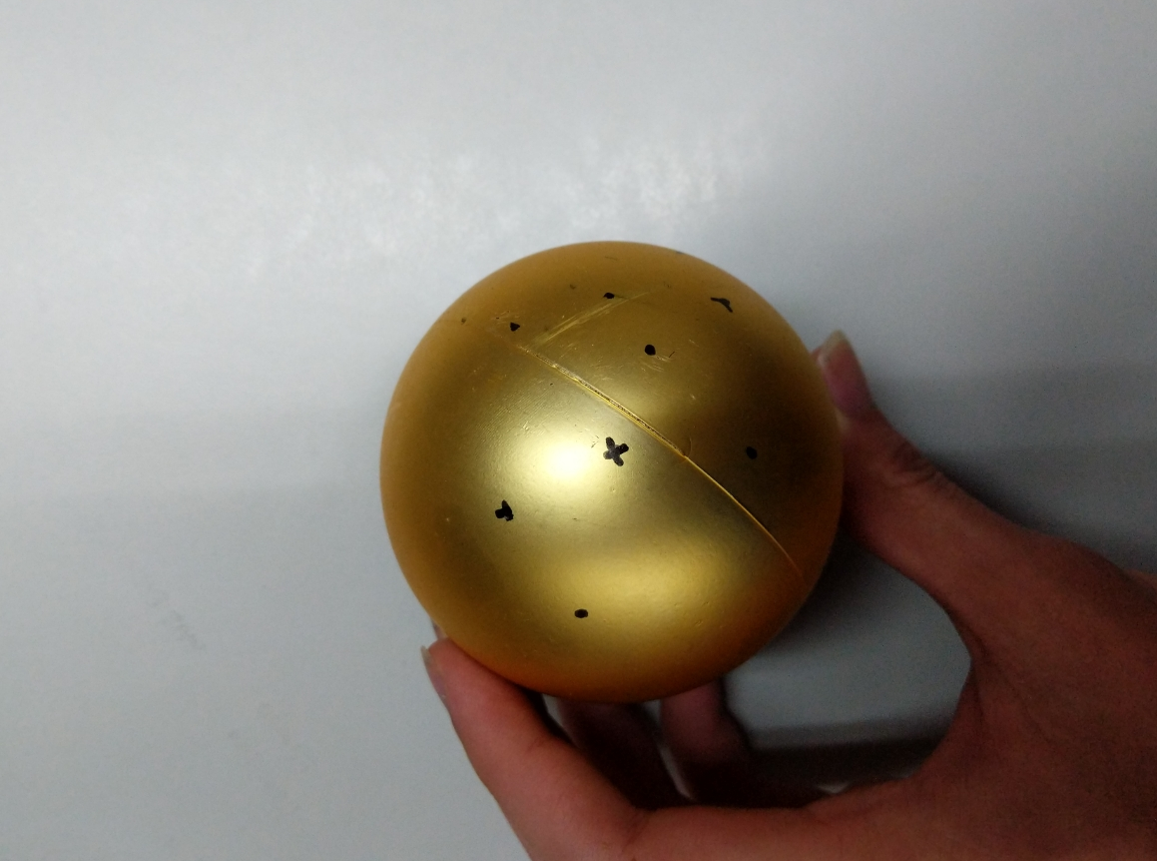
Object Location
Assume it is an isotropic ball
(can be determined by 3 points on its surface given radius)
Use 3 (or 4) markers
Stereo with hand-picked marker pixels
Similar approach applied to light source
(LED itself is a marker)

Slide 29
Calibration – Difficulties
Too dark to recognize the chessboard and feature
Random Errors
WE CANNOT FIND THE MARKER

Slide 30
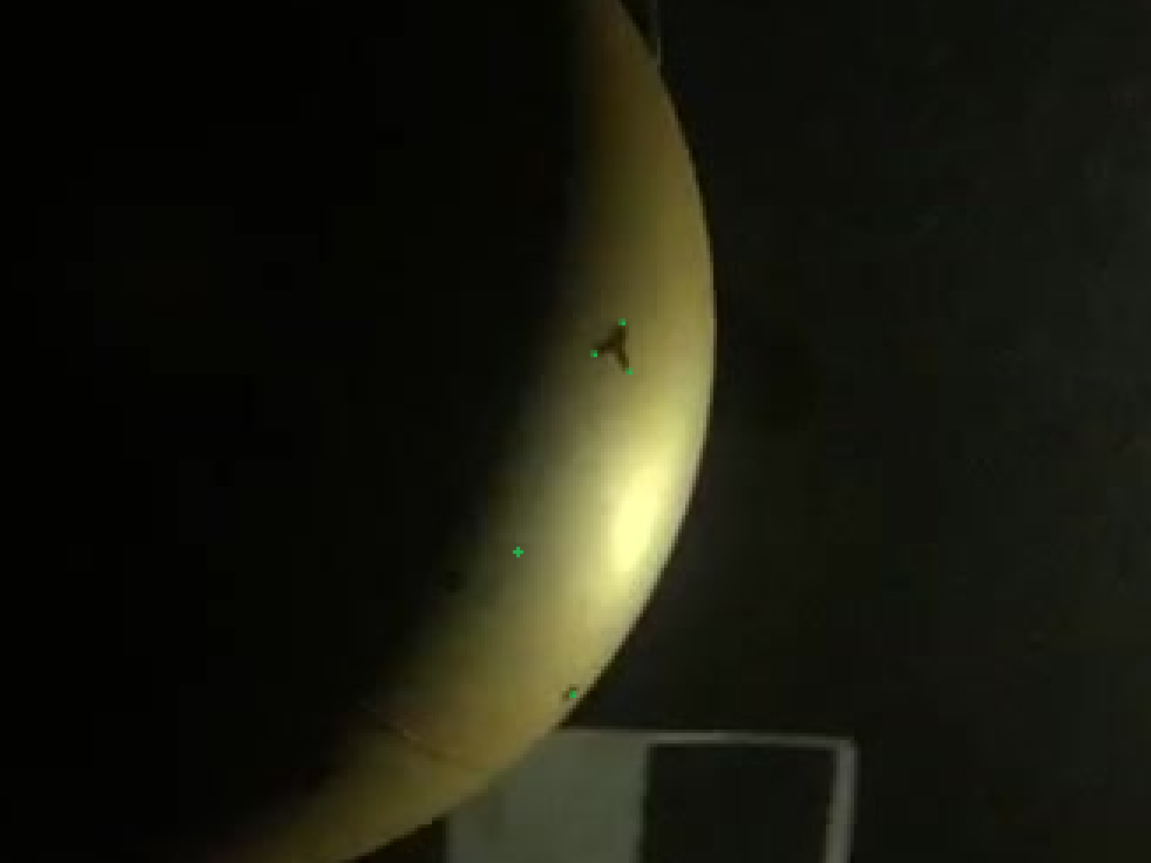
Calibration – Difficulties
Too dark to recognize the chessboard and feature
Random Errors
WE CANNOT FIND THE MARKER

Slide 31
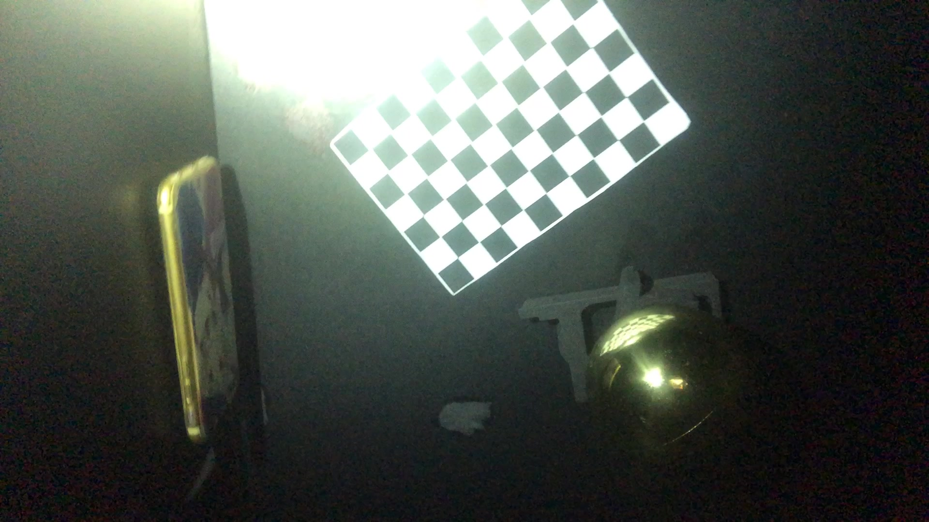
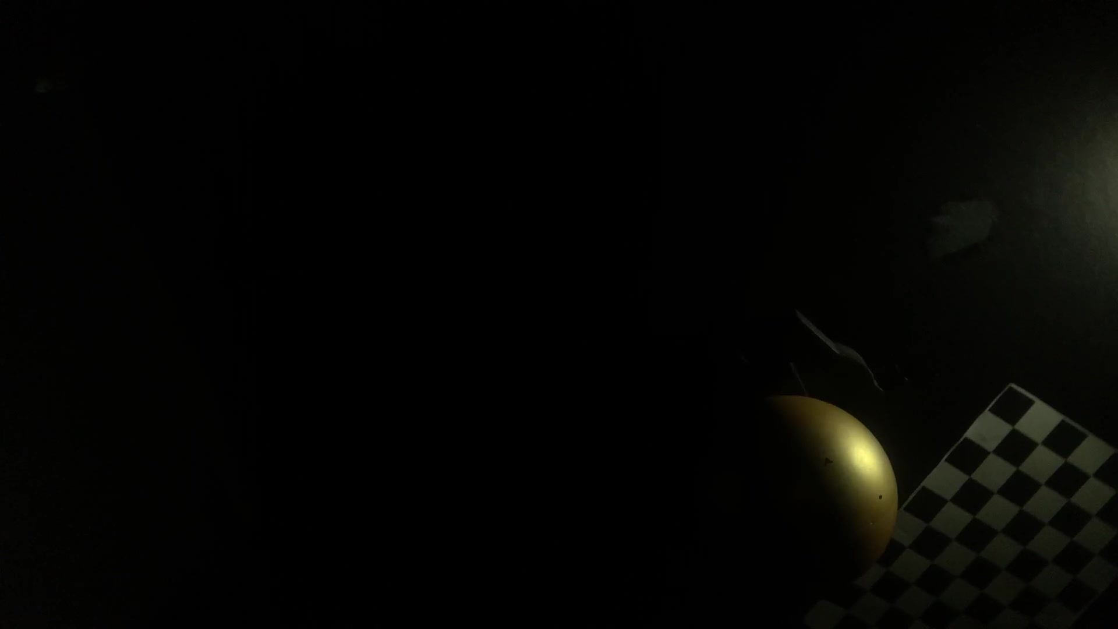

Slide 32
BRDF Measurement
Calibration -> angular velocity
-> FOV
-> Camera location and Pose

Slide 33
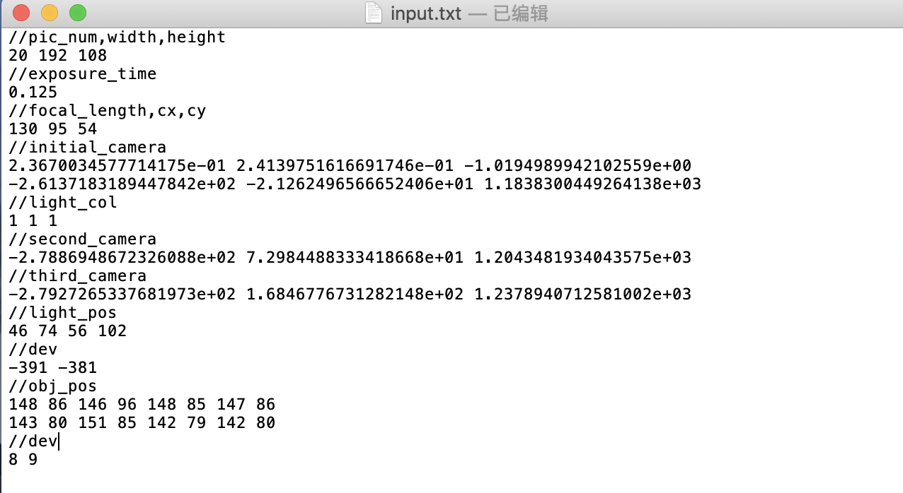
BRDF Measurement

Slide 34
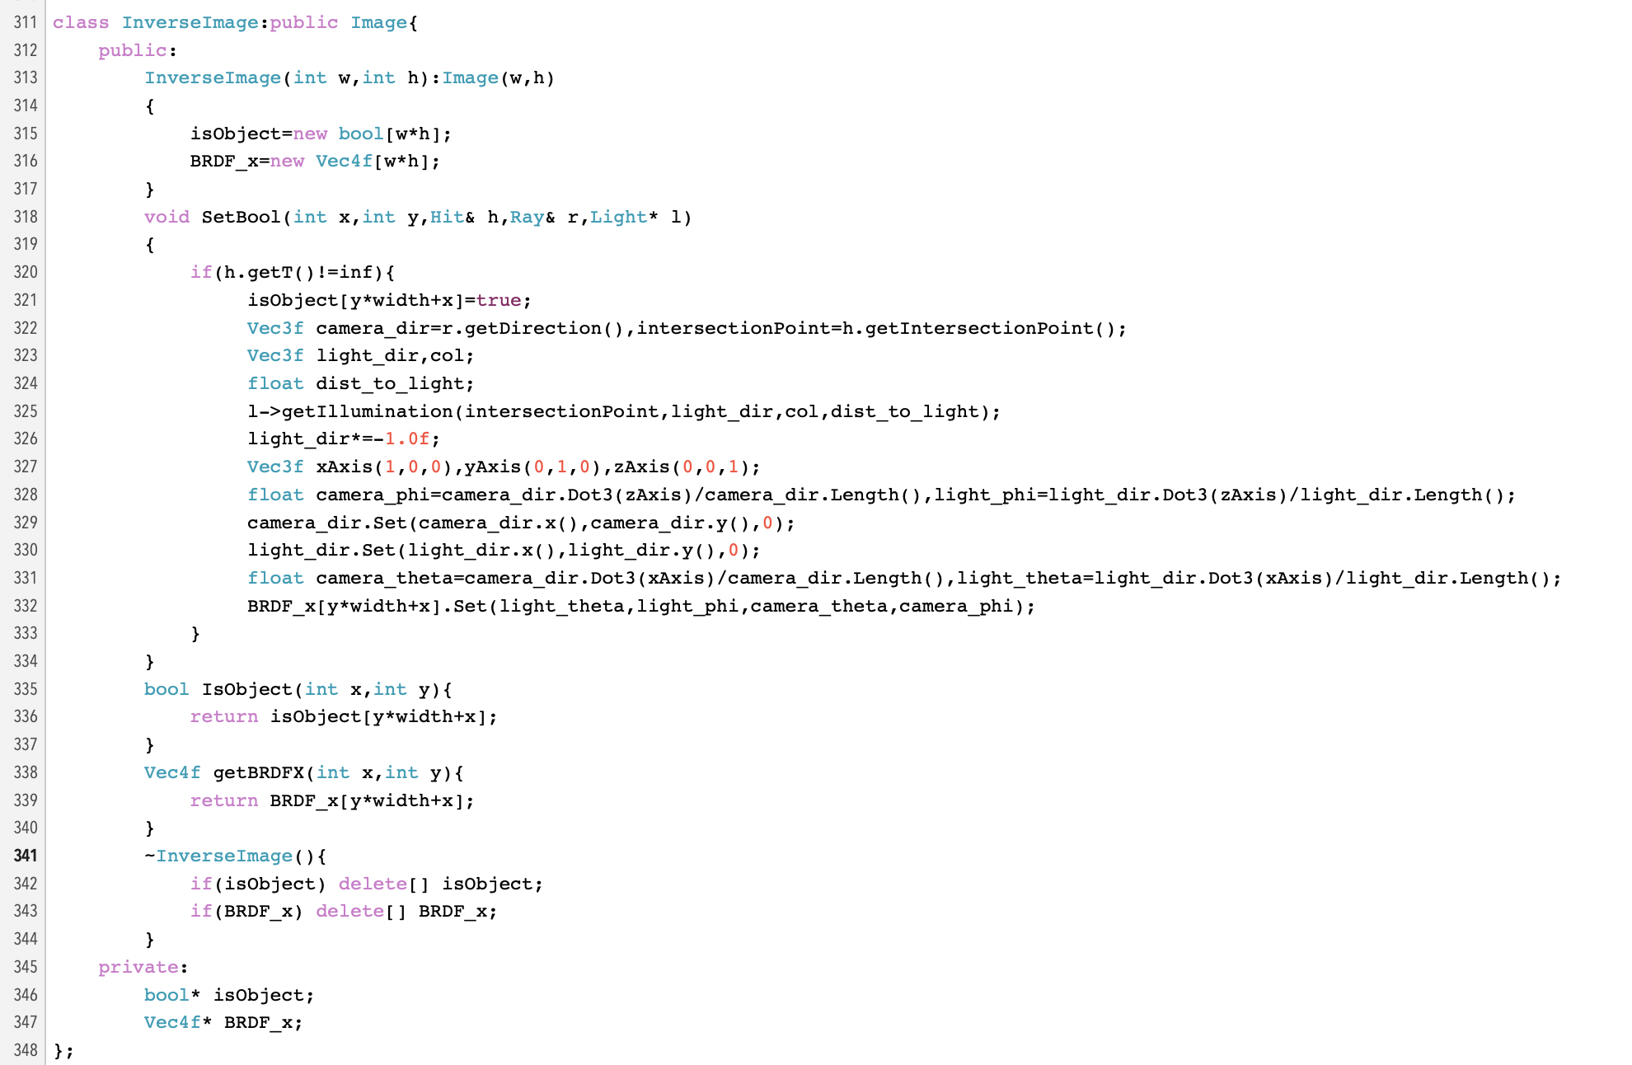
BRDF Measurement

Slide 35
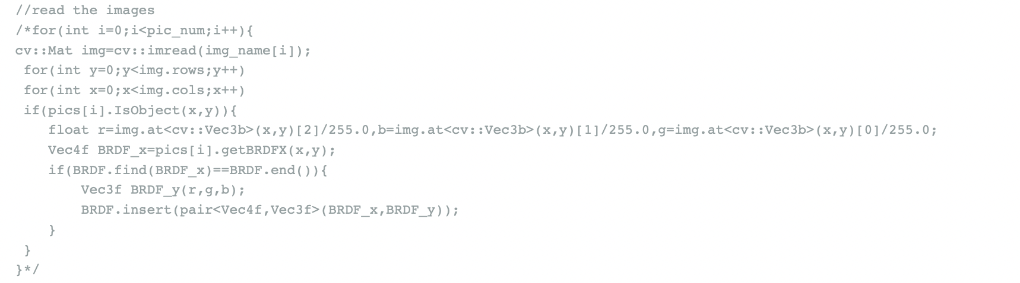
BRDF Measurement

Slide 36
BRDF Measurement
The process of getting BRDF arguments is equivalent to rendering
Opencv gets the RGB value of BRDF, which is the dependent variable of BRDF

Slide 37
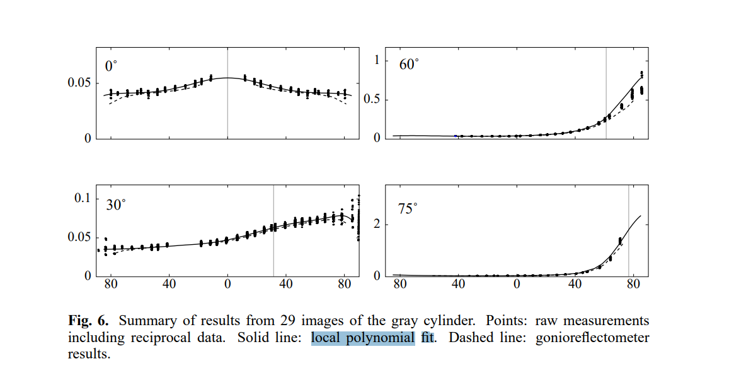
Fitting
Local Polynomial Fitting

Slide 38
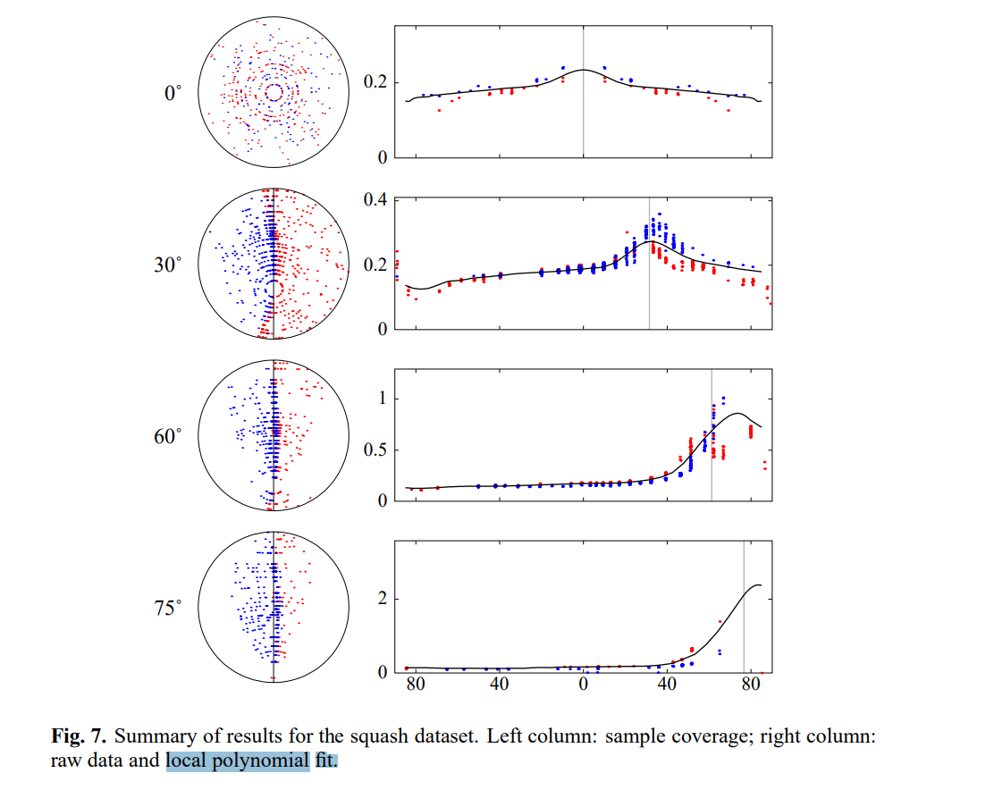
Fitting
Local Polynomial Fitting

Slide 39
Fitting
Aim and result

Slide 40
Improvement can be done
RGB Calibration
Consider the influence of ambient light

Slide 41
Why We Failed
Hardware (Little Experience, No Foundation(in both meaning))
Software (No Previous Wheels)
HUGE ERROR
High Coupling Labor Division

Slide 42
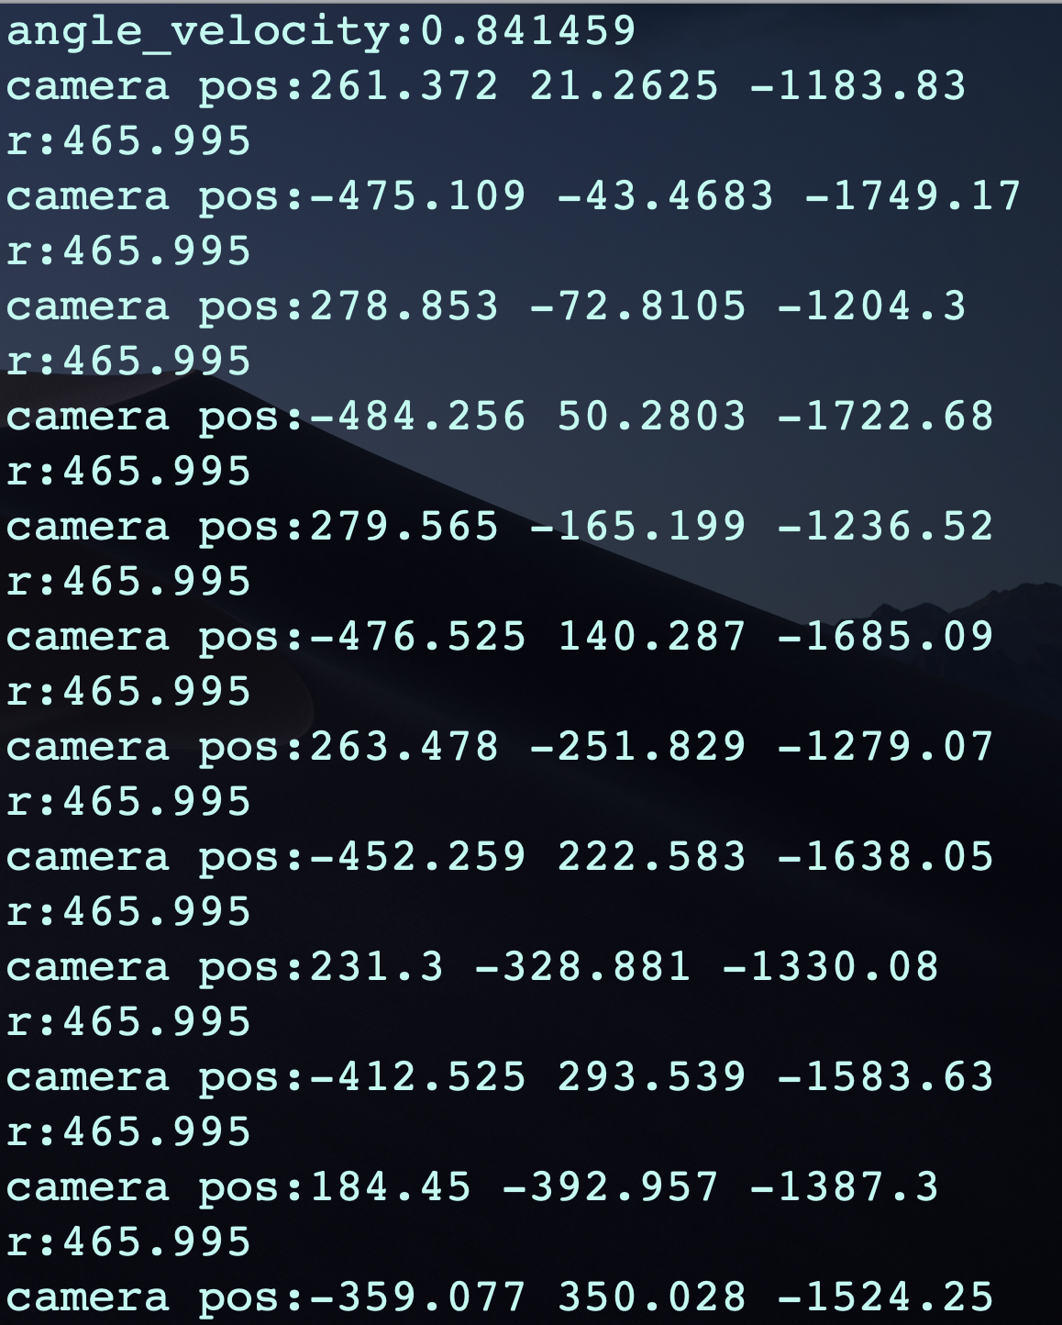
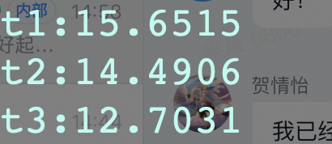
Why We Failed

Slide 43
However, we may have...
Experience of building from scratch
Careful Thoughts
Next time,fail better...
Actually, only one last step to do!
At last, a delicate box...

Slide 44
实验要笑(啸)着做.jpg
纪念(奠)每节实验课/大作业讨论必吵架的我们组

